Slide 1


Star and Save
Convert vs. Non-Convert Survey Results
Kelly Peterson
Date: May 16, 2023

Slide 2



Research Approach
RESEARCH PARTICIPANTS
For this study we received a limited amount of completes due to the following reasons:
High list suppression/many communications going to the same Cx
End of experiment/inability to add more sample
Low rate of awareness/use of Star and Save among sample
For this reason all insights should be considered directional and are not statistically significant
Sample sizes are shown on the bottom right side of each slide
UXR Recommends we repeat study when V2 launches
We conducted a 10 min survey with Cx who were exposed to the Star and Save treatment
Located in a Star and Save test market
In the Star and Save treatment group
Logged into the app during the time of Star and Save
The goal of this research was to get a deeper understanding of
Feature awareness
Feature understanding
Strengths and barriers to adoption
The research brief can be found here. The data tables can be found here. You can also see results from initial pulse check interviews here.
Notes:
James to link to failed session

Slide 3


Slide 4
Awareness and stated usage is relatively low; however insights align with behavioral data for respondents
40%
28%
22%
of Cx stated that they have “starred” a Rx*
of Cx stated they have completed a star and save order*
of Cx were aware of the Star and Save feature
(aided and unaided recall)
35% of sample starred a Rx according to behavioral data
15% of sample converted according to behavioral data
N=88 Cx exposed to Star and Save Treatment
*N=32 Cx aware of Star and Save

Slide 5


Cx understand Star and Save with the exception of number limitations and how it works beyond your first order
Of the Cx that indicated they were aware of Star and Save, 87% were able to accurately describe it (with just a few missing details).
You click the star, you get 3 total. You get free delivery.
Common errors that Cx made in their description:
You can star up to 3 of your favorite participating restaurants and save on delivery fee and taxes
Only frequently ordered Rx can be starred
Starred Rx always show at the top of your screen
Incorrect number to star or to switch
You save on both fees and taxes
Star a restaurant and you won’t have to pay delivery fees, it’s used for restaurants you order from often.
Select 3 favorite restaurants and receive $0 delivery fee
If you star or favorite a restaurant, certain fees are waived, specifically the delivery fee.
N=24 unaided recall

Slide 6



Cx that are aware of Star and Save and generally strong sentiment to it
58% of Cx rated “Star and Save” as extremely or somewhat useful
65% of Cx rated “Star and Save” as extremely or somewhat easy to use
41% of Cx rated were extremely or somewhat satisfied with Star and Save as an offering
N=51 Cx who are in Star and Save treatment group

Slide 7
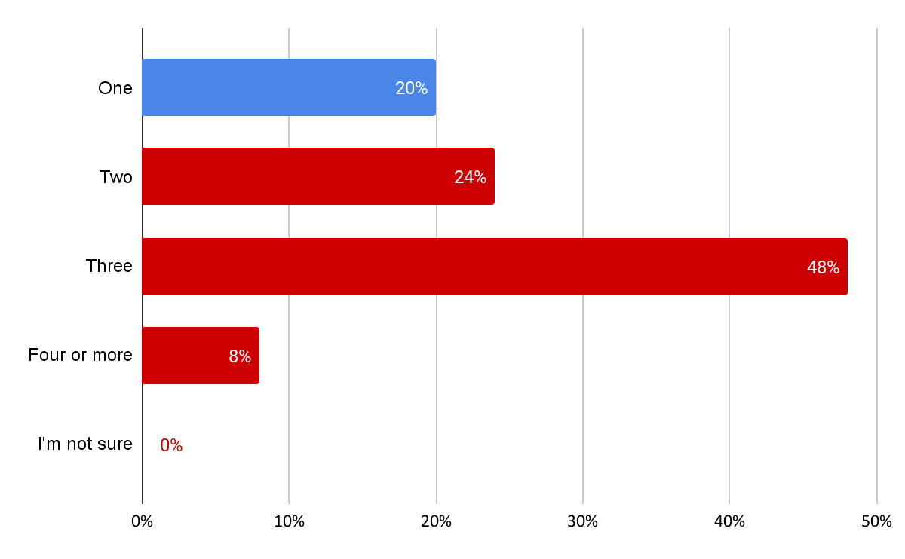

Cx are likely to forget to “go back” to finish starring all 3 Rx
Number of items Cx indicated they “starred”:
Of the 5 Cx that only “starred” one store, 2 used the pre selected store.
These Cx indicated that they had not “Starred” more Rx because they haven’t gone back to it yet or couldn’t decide.
“I got distracted and forgot to go back and finish”
“I haven’t had a chance to add more”
“I’m not sure what other restaurants I would regularly order from”
“I have not confirmed other restaurants”
N=25 Cx who starred an Rx

Slide 8



Difficulty selecting Rx and inconsistent experiences are the greatest stated barriers to star and save adoption
Picking restaurants:
Placing an order at a starred Rx:
Savings/Cost:
Do you just start starring your three places, or do you have to opt in to this first?
There’s not that many restaurants available with star and save in my area
I would like to change the restaurants I did not realize that you couldn’t do that when I selected them.
It's confusing because. I picked my star restaurants one day. I went back to the app the next day and the restaurant I starred was not available for a $0 delivery fee.
Doordash didn't save my starred restaurants. When I went back to order, the app didn't offer me a $0 delivery fee for the restaurant I had chosen.
It does alleviate some fees but the markup in the first place on items is high
Would like to have more savings since prices are up as well as more selection
N=51 Cx who are in Star and Save treatment group

Slide 9
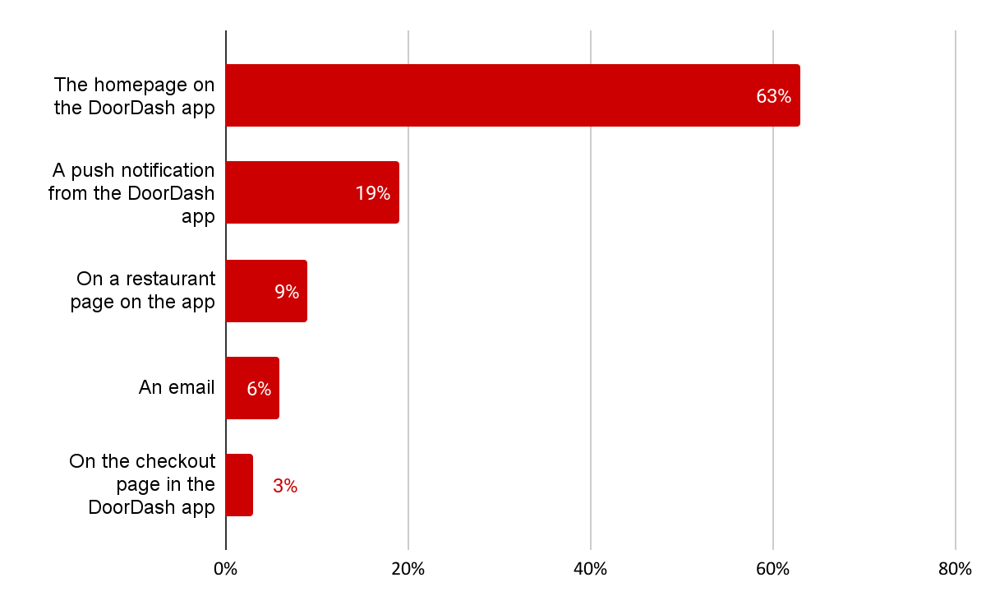

The majority of Cx education is coming from the home screen
Location where first learned about Star and Save:
27% of Cx recall seeing marketing about the Star and Save Feature
 | # of Cx
Banner ad on app | 6
Push notification | 4
Email | 3
At checkout | 1
N=32 Cx aware of Star and Save

Slide 10
Insights & V2 Considerations
Cx need a more direct reminder/reinforcer when placing their second star order. Cx expect their starred restaurants to always be at the top of their homepage and therefore may be confusing them with “order again” or “favorite” restaurants. This is leading to Cx feeling their stars where not applied for a repeat purchase. We may want to explore reminders, similar to the reminders we provide when you have a credit or cart available when logging onto the app.
We need to make it easier to complete your 3 restaurants. Cx indicated they often forget to go back and completed their starred restaurants or feel anxiety about which restaurants to select. Creating guardrails and gentle reminders should help Cx get over this hurdle.
Cx are getting most of their feature education on the homescreen via the carousel. This may be attributing to some areas of confusion as there is limited ability for us to communicate the details of the feature within this space. V2 should include more Cx testing to ensure we have the most important details on the home page and email/push notifications may need to be timed closer to version launch.
Limitations around Rx selection may help balance discount concerns. Some Cx are looking for a bigger discount because their starred Rx includes one with price markups. If we explore a guarded selection in V2 we should ensure selection includes Rx that have not added high levels of menu item inflation

Slide 11
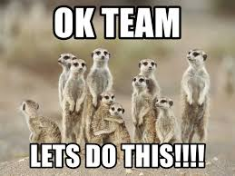
Questions? Ideas? Thoughts for V2?

Slide 12
Appendix

Slide 13
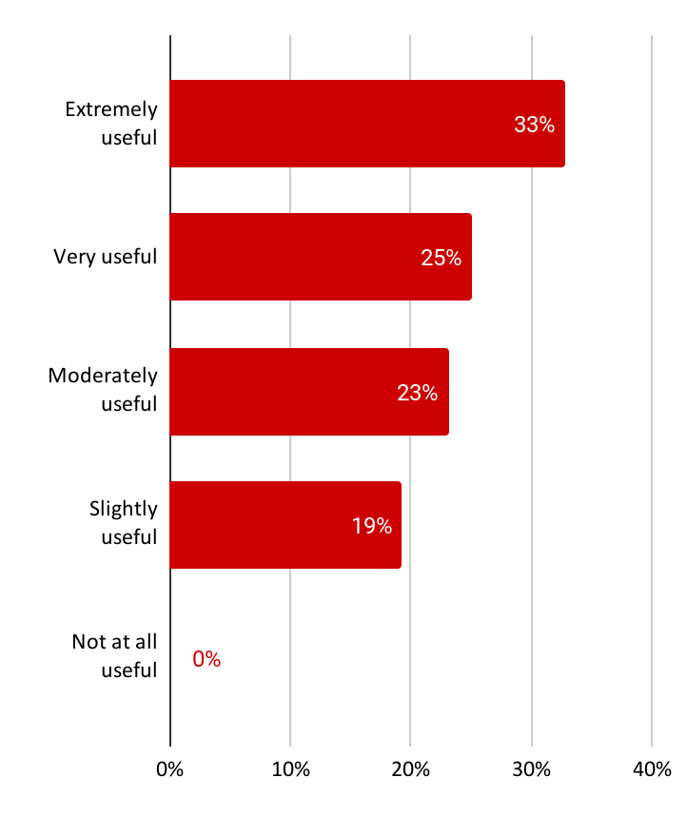
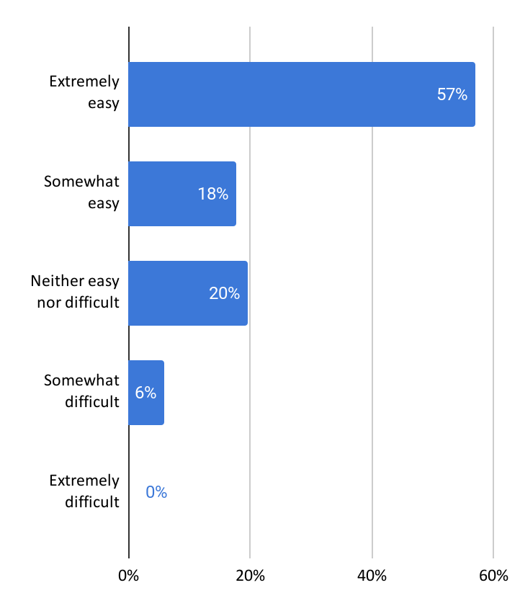
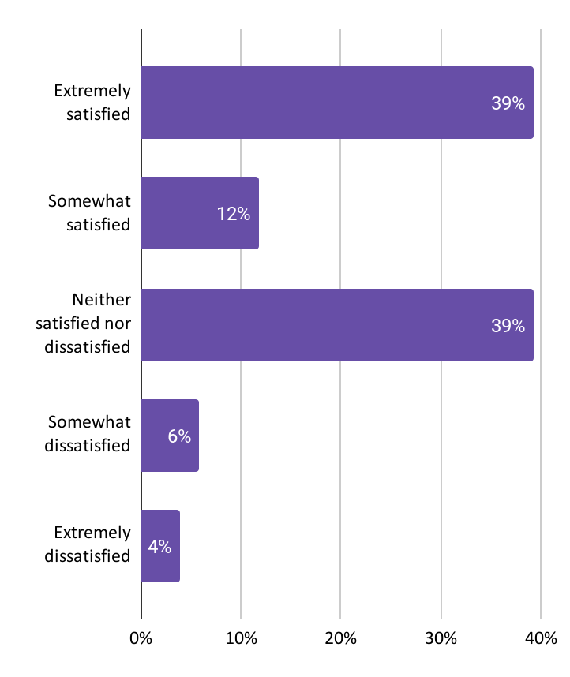
Reactions to star and save
N=51 Cx who are in Star and Save treatment group

Slide 14

More insights

Slide 15
Taste of DashPass Concept Test
Research questions covered:
Category | Priority | Questions
Rotation | P0 | How do Cx feel about the rotation of restaurants? How long should an Rx be in the rotation? What feels fair? What format should be used for the rotation? How important is new vs. what is going away? What do they think they would do if a preferred Rx rotates out? What categorization of Rx would they want to see in the rotation?
Interest & Clarity | P0 | Do Cx care about the Taste of DashPass offering? Is it exciting? Do Cx understand the Taste of DashPass offering? Do they understand all of the steps? To what level should they be broken out/not broken out? What limitations do Cx feel exist? Where might there be areas of confusion? Where would Cx go to try to find more information?
DashPass | P1 | Does the connection to DashPass make sense? Does it feel differentiated from DashPass content they see today (trial, upsell)? Do Cx understand that Taste of DashPass is free, and they sign up as a preview? How might Taste of DashPass change their view of DashPass? How might understanding of the rotation impact DashPass sign ups?

